Slide 1

Movies Hub: Building a Scalable Movies App
for User Experience using MERN
Seshadri Rao Gudlavalleru Engineering College, Gudlavalleru
Department of Computer Science and Engineering
By
I. Karthik 22481A0581
K. Gayatri 22481A05C2
J. Suvishesh 22481A0583
G. Sankara Naga Shyam 22481A0567
Under the guidance of
Mrs. K. Nandini, M. Tech, (Ph.D.)
Assistant Professor, Department of CSE

Slide 2
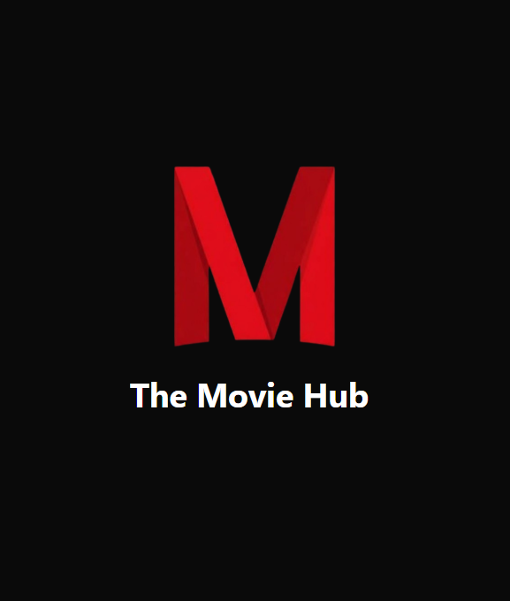
ABSTRACT
The Movie Browsing Application is a web-based platform that allows users to explore movies across multiple languages using real-time data fetched from the TMDB API. Users can log in to personalize their experience, search and filter movies by language, view trailers through YouTube links, read reviews, and access external links to book movie tickets. The system also enables users to create and manage their own watchlist and favourites, offering a more engaging and convenient movie discovery experience. By combining user-focused features with dynamic API-driven content, the application delivers a fast, interactive, and seamless movie-browsing experience.

Slide 3
INTRODUCTION
The Movie Browsing Application provides users with an intuitive and personalized platform to explore movies across multiple languages, meeting the growing demand for instant and reliable online entertainment information. By integrating the TMDB API, the system delivers up-to-date movie details, ratings, reviews, trailers, and media content, while allowing users to browse by language, search for titles, watch YouTube trailers, and access external ticket-booking links. Secure user login enables personalized features such as managing watchlists and favourites, and the clean, responsive interface ensures smooth navigation and filtering. With dynamic content loading, multilingual support, and user-focused design, the application showcases an effective implementation of scalable, interactive, API-driven web development.

Slide 4
OBJECTIVES
Provide a simple platform to browse movies by language.
Fetch real-time movie data using the TMDB API.
Enable users to login and manage watchlist and favourites.
Allow movie search and filtering across languages.
Provide trailers, reviews, and ticket-booking links.
Ensure a fast, responsive, and user-friendly interface.

Slide 5
PROBLEM STATEMENT
With the growing demand for digital movie platforms, users often face difficulty accessing reliable, multilingual movie information in one place. Many existing platforms do not provide features like personalized watchlists, favourites, integrated trailer viewing, or direct ticket-booking links. The lack of a centralized and user-friendly interface makes movie discovery less efficient and less engaging. Hence, there is a need for a comprehensive system that delivers real-time movie data using APIs, supports multilingual browsing, and enhances user convenience through personalization and interactive features.

Slide 6
METHODOLOGY
1. Requirement Analysis
Collected user needs such as multilingual movie browsing, search, trailers, watchlists, and favourites.
Identified the need for real-time movie data through the TMDB API and secure user authentication.
2. System Design
Designed UI/UX layouts for browsing, movie details, login, watchlist, and favourites.
Planned backend structure for handling authentication, user data, and API communication.
Designed database models for users, watchlists, and favourites.
3. API Integration Planning
Studied TMDB API endpoints to retrieve movie details, reviews, posters, and language-based results.
Planned integration of YouTube trailer links and external ticket-booking URLs.
4. Frontend Development
Built components using React for movie listing, details, search, filter, login, and watchlist.
Implemented routing, state management, and reusable UI elements.

Slide 7
METHODOLOGY
5. Backend Development
Implemented user authentication using Node.js, Express.js, JWT, and password hashing.
Created routes for managing user-specific data like watchlist and favourites.
6. Feature Integration
Added search, language filters, favourites, and watchlist functionality.
Displayed trailers, reviews, ratings, and booking links on the movie details page.
7. Testing
Performed functionality testing, API response testing, and UI/UX testing.
Fixed issues related to navigation, responsiveness, and data loading.
8. Deployment
Deployed frontend and backend on a cloud platform ensuring smooth performance across devices.

Slide 8
IMPLEMENTATION
1. Frontend Implementation
Developed using React.js with components for home, movie details, watchlist, favourites, and login.
Used React Router for page navigation and Axios/fetch for API calls.
Implemented search and language filter options for easier browsing.
Displayed movie posters, ratings, language, and overview using TMDB API data.
2. TMDB API Integration
Connected the app to the TMDB API to fetch real-time movie information including titles, posters, reviews, and ratings.
API responses were processed and rendered in movie listing and details pages.
YouTube trailer links were fetched and attached to respective movie details.
3. Authentication System
Implemented JWT-based login system using Node.js and Express.js.
Passwords were hashed using bcrypt for security.
Tokens were stored on the client side to access user-specific features.

Slide 9
IMPLEMENTATION
4. Watchlist & Favourites
Users can add or remove movies from their watchlist and favourites.
These lists are stored in the database and displayed by fetching user-related entries.
Separate pages show all saved items for easy access.
5. Movie Details & External Links
A detailed movie page displays overview, release date, language, reviews, and trailer options.
YouTube trailer links allow users to watch movie trailers externally.
Ticket-booking links redirect users to booking platforms.
6. Multilingual Search & Filter
Users can browse movies based on language categories.
Search bar helps look up movies by title.
Combined filters improve movie discovery capabilities.
7. Responsive UI
The interface was styled to be modern and responsive for both mobile and desktop devices.
Components are designed to maintain consistent layout and performance.

Slide 10
PROJECT FLOW
User Login/Registration: The user logs in or creates an account to access personalized features.
Fetch Movie Data: The system retrieves real-time movie information from the TMDB API.
Browse & Filter: The user browses movies by language and uses search or filters to refine results.
View Movie Details: The user opens a movie to see details, reviews, and YouTube trailer links.
Manage Watchlist/Favourites: The user adds or removes movies from their watchlist and favourites.
Ticket Booking: The user follows external links to book movie tickets.

Slide 11
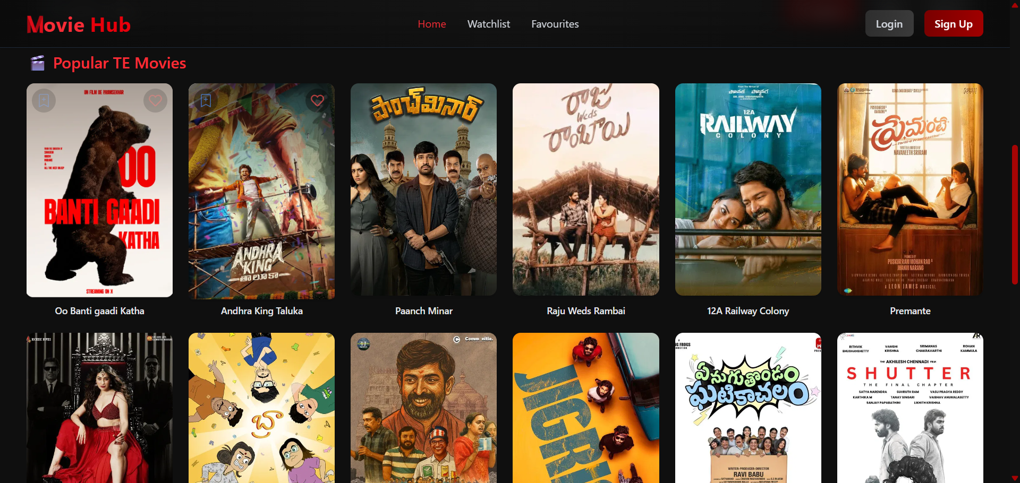
EXECUTION DEMO IMAGES

Slide 12
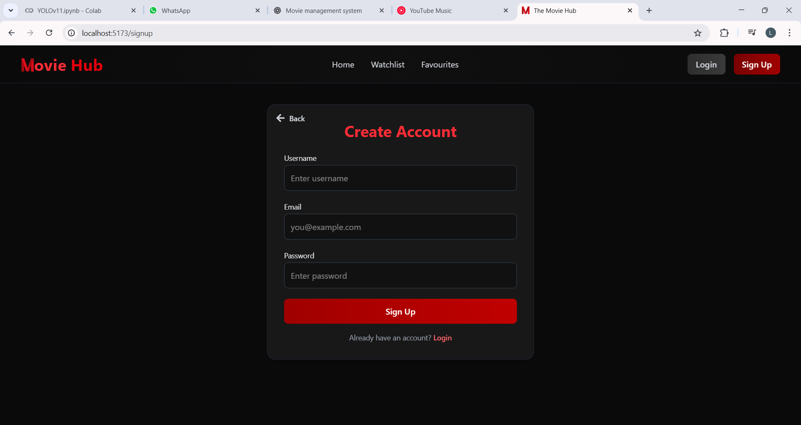
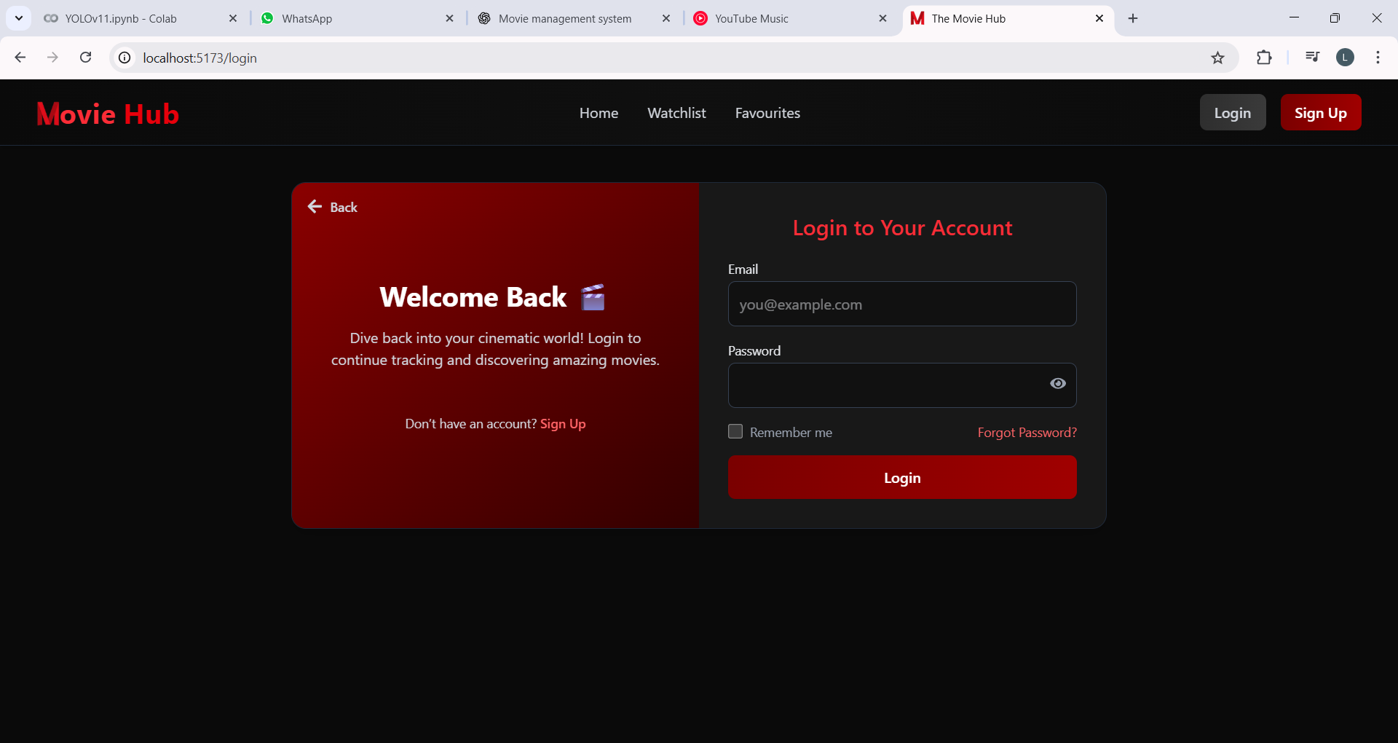

Slide 13
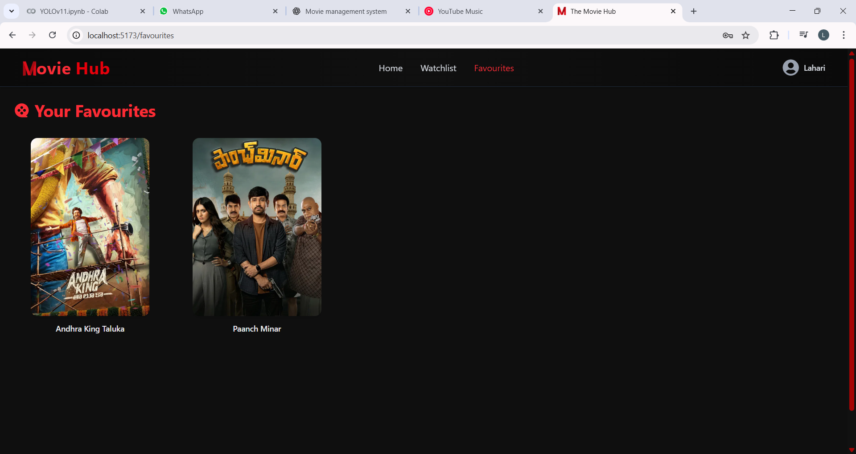
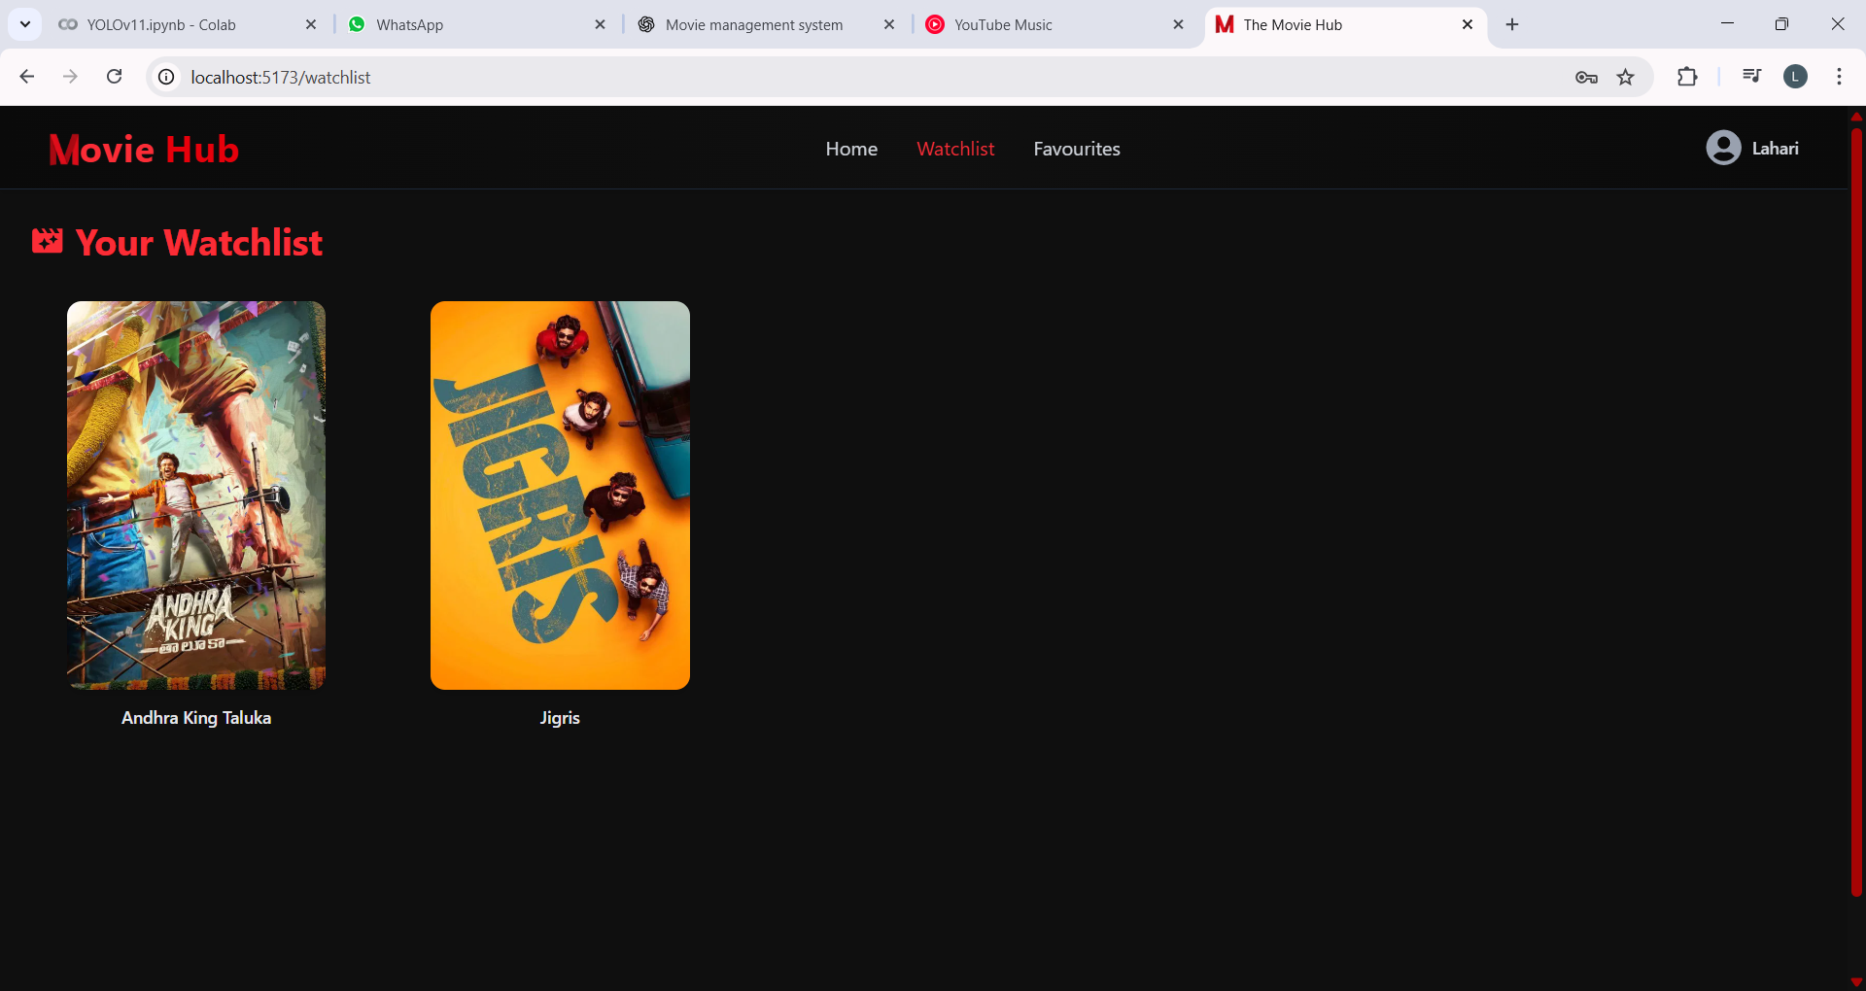

Slide 14
CONCLUSION
The Movie Browsing Application provides a simple, responsive, and personalized platform for exploring movies across multiple languages. With real-time data from the TMDB API, users can easily access trailers, reviews, ratings, and detailed movie information. Features like search, filtering, watchlists, and favourites enhance convenience, while secure authentication ensures a reliable user experience. Overall, the project demonstrates effective use of the MERN stack to build a scalable, interactive, and user-friendly movie discovery system.

Slide 15
THANK YOU

